Slide 1
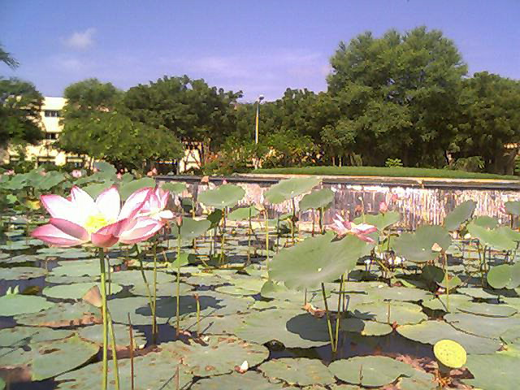
SC107 Class 1

Slide 2

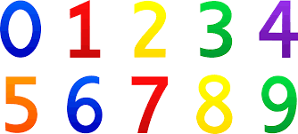
SC 107 Calculus
Lecture 1: Admin Details & Background Building
Prof. Nabin K. Sahu
Faculty Block-4, Room No-4212
SC107 Class 1

Slide 3
Outline of Presentation
Instructor, Tutors and Teaching Assistants
Overview and Subject Classification
Course Outline
Course Policy
Attendance Policy
Some Warnings and Advise
SC107 Class 1

Slide 4
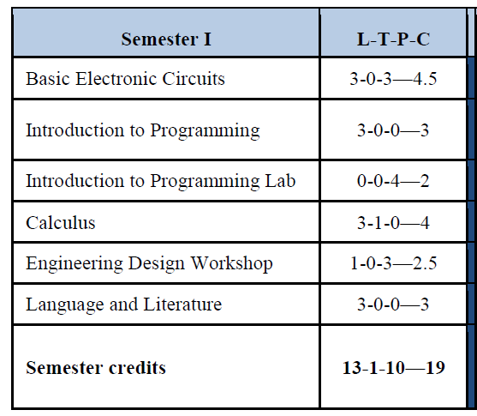
Your Courses Autumn 2018-19
SC107 Class 1

Slide 5
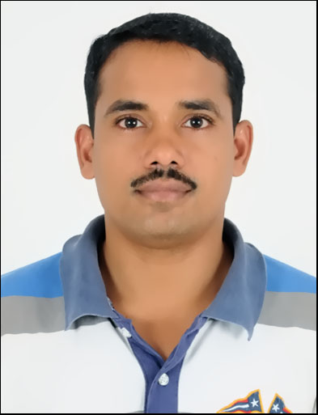
SC 107 Instructor
Know your Instructor
Dr. Nabin K Sahu
Office: Room 4212 Faculty Block 4
Email: nabinkumar_@daiict.ac.in
Phone: 91-79-30510642
SC107 Class 1

Slide 6
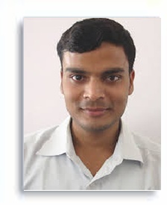
SC 107 Tutor
Krishna Gopal,
Room Lab 202 , Phone: 522
Email: krishna_gopal@daiict.ac.in
SC 107 Teaching Assistants
Makda Taher Mustfabhai (201811031)
Abhimanyu Singh Bisth (201811051)
Prachi Naik (201811035)
Parv Chadha (201501002)
Yagnesh Chauhan (201501206)
SC107 Class 1

Slide 7
SC 107 Timings
Lectures (Slot-6)
Monday 11:00 am (LT-3)
Wednesday at 12:00 (LT-3)
Thursday 11:00 am (LT-31)
Tutorials (2:00-2.55 pm)
Monday (Group 4, Room CEP 203)
Tuesday (Group 5, Room CEP 203)
Wednesday (Group 1, Room CEP 203)
Thursday (Group 2, Room CEP 203)
Friday (Group 3, Room CEP 203)
SC107 Class 1

Slide 8
SC 107 Overview and Subject Classification
This exciting course is foundation to your ICT degree.
Basic calculus of real variables
Basic calculus of complex variables
Differential Equations
(Ordinary and partial differential equations with a few applications)

Slide 9
SC 107 Course Outline-1
Week | Tentative Topics
1 (July 30) | Introduction, functions of single variable-Mean value theorems and Taylor's theorem
2 (Aug 13) | Fundamental theorem of integral calculus, definite integrals
3 (Aug 20) | Functions of several variables-Partial derivatives, chain rule, chain differentiation, implicit functions and Jacobians
4 (Aug 27) | Taylor's theorem for functions of several variables, maxima, minima and saddle points
5 (Aug 30 - Sep 1) | Test 1 (First Mid Term)
6 (Sep 3) | Multiple integrals
SC107 Class 1

Slide 10
SC 107 Course Outline-2
Week | Tentative Topics
7 (Sep 10) | Complex Variables-Introduction, Continuity
8 (Sep 17) | Complex Variables-Differentiability and analyticity
9 (Sep 24) | Complex Variables-definite integrals (contour integrals-line integrals)
10 (Oct 1) | Cauchy integral theorem and formula, Taylor and Laurent series, zeroes, singularities and residues
11 (Oct 8) (Oct 13-Oct 16) | Test 2 (Second Mid Term)
SC107 Class 1

Slide 11
SC 107 Course Outline-3
12 (Oct 15) | Ordinary differential equations-ODE of first order, linear ODE of second and higher order with constant and non-constant coefficients
13 (Oct 22) | Non-homogeneous equations, power series solutions to ODEs
14 (Oct 29) | Partial differential equations-Classification of PDEs Diffusion equation: separation of variables
16 (Nov 3 –Nov 11) | In Semester break
17 (Nov 12) | Wave equation, separation of variables, vibrating string and d'Alembert's solution
18 (Nov 19) | Laplace Transforms & Fourier Transforms
19 (Nov 28- Dec 05) | Test 3 (Final Exam)
SC107 Class 1

Slide 12

Nov 3 to Nov 11 (Holiday Week)
SC 107 Application Home Assignment Time
Semester Break: Happy Deepawali (Nov 7)
SC107 Class 1

Slide 13
Marks Distribution (Tentative) / Grading Policy
Test 1 | 25%
Test 2 | 25%
Test 3 | 40%
Assignment+Tutorials & Class Attendance | 10%
Total | 100%
SC107 Class 1

Slide 14
Tutorials Policy
One Tutorial per week with some additional bonus problems for you to enjoy in the evening tea time !
You need not to submit your Tutorial but attendance is mandatory as any time surprise quiz may occur and discussions will be useful !
SC107 Class 1

Slide 15
Attendance Policy
Each of you must attend each lecture as 80% attendance is compulsory. There could be a surprise quiz at any time in Lectures or Tutorials.
SC107 Class 1

Slide 16

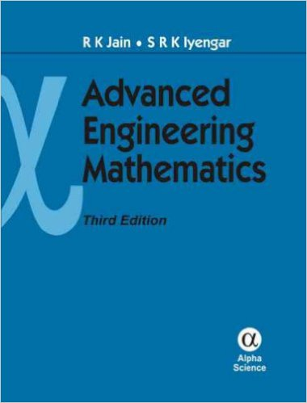
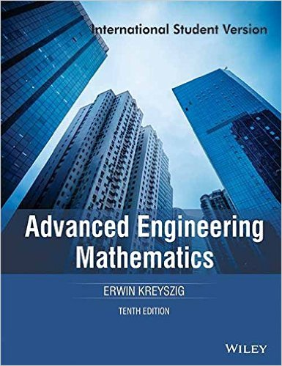
Thomas Calculus (Must have !)
Advanced Engineering Mathematics,
1. Jain, RK and SRK Iyengar, 3rd edition, Narosa, 2007
New Delhi, India (Reference Book)
2. Erwin Kreyszig, Paperback: 1148 pages Publisher: Wiley; 10 edition (23 March 2015) India (Reference Book)
Occasionally there will be reading advice in every week or lectures for some additional material
SC107 Class 1

Slide 17
Moodle Course Web Page
Moodle Course Web Page:
http://courses.daiict.ac.in//course/view.php?id=410
Create your login with your daiict email address as and when you get it at http://courses.daiict.ac.in
Register for the course SC 107 at Moodle
SC107 Class 1

Slide 18
Some Warnings and Advise
SC107 Class 1

Slide 19
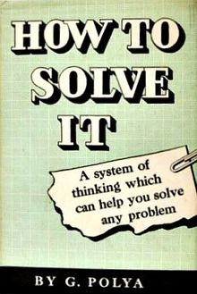
Advice on Problem Solving
Please attend (and participate…) each lecture and tutorial
Mark your doubts and clear them that week itself
Step 0: Think about it for 15 minutes
First, you have to understand the problem
After understanding, then make a plan
Carry out the plan.
Look back on your work: How could it be better?
Step 1: Ask your peers, Ask your seniors
Step 2: Ask the TAs, Ask the Tutors
Step 3: Finally ask the mentors
"If you can't solve a problem, then there is an easier problem you can solve: find it." Or: "If you cannot solve the proposed problem, try to solve first some related problem. Could you imagine a more accessible related problem?"
SC107 Class 1

Slide 20
Common Mistakes Students Make !
Do not go to the class as first year is rest year
Study only from exam point of view
Study towards the exam date
Calculus I know from my 10+2 so there is no need to learn
Receive advice from bad seniors
(Listen to some good seniors who have achieved something)
Thinking that CPI is not important
Not having a study plan
Sometime it is good to study in groups
Not reading the text book
Only studying few courses and not paying attention to all courses
Playing games on computers or just wasting time in gossip
I could not get admission in computer science so I will not study this ICT
SC107 Class 1

Slide 21
A Good Plan for your BTech (ICT)
First year (particularly 1st semester) just focus on study (you will not get time for extra activities)
Once you are in good shape CPI wise and you have a better understanding of the system you will observe that you are getting extra time for many other activities
Learn programming languages by taking a big project in Summer or Winter breaks (at least 15K lines program): C, C++, Java, Python etc…
You require strong mathematical/ algorithmic/problem solving/analytical skills
SC107 Class 1

Slide 22
Objectives: SC107
Developing a thinking process for solving difficult problems in other words developing mathematical (problem solving) skills
Understanding limit, continuity, differentiability and integration for real and complex variables
Solving Ordinary and Partial Differential Equations
Some applications using Laplace and Fourier transforms
Later on in other courses you will see how these skills are applied in understanding and solving the real world engineering problems
SC107 Class 1

